Slide 1
PLACEMENT MANAGEMENT SYSTEM
SEMANTIC BASED APPLICATION

Slide 2

AIM & USAGE
PLACEMENT MANAGEMENT SYSTEM IS SEMANTIC BASED WEB APPLICATION WHOSE MAIN MOTO IS TO HELP STUDENTS FIND THEIR PLACEMENTS IN DIFFERENT COMPANIES ACCORDING TO THEIR REQUIREMENTS ,VACANCIES,LOCATION AND THE RANKINGS.
THIS APPLICATION IS CREATED TO OVERCOME THE TYPICAL METHOD OF FINDING PLACEMENT WHERE STUDENT FIND IT VERY DIFFICULT TO FIND A COMPANY.A STUDENT NEEDS TO TRAVEL,FIND DIFFERENT COMPANIES OFFEREING PLACEMENT AND ALSO DROP RESUME EACH AND EVERY WHERE.
ON THIS APPLICATION,A STUDENT CAN SAVE HIS TIME,SAVE MONEY AND ALSO CAN FIND ACCURATE OPTIONS FOR DOING PLACEMENTS AFTER HIS GRADUATE STUDY OR POST GRADUATE STUDIES.

Slide 3
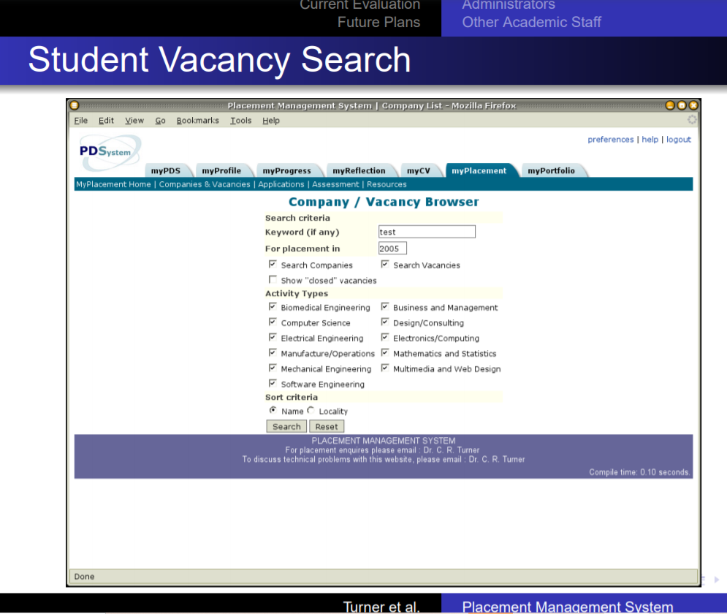
PURPOSE OF THE APPLICATION
The purpose of this semantic based application is to create a link between the companies, students and universities.
Students can search different companies for placements according to their previous studies.
Companies can find out students from different universities by analyzing their profiles.
And also universities can link themselves with different companies so that the students of the respective university can get advantage of

Slide 4



TECHNOLOGIES USED:
TO MAKE ONTOLOGIES PROTÉGÉ HAVE BEEN USED.
THE APPLICATION IS MADE WITH ASP.NET EMBEDDED WITH C# AND MVC.
DATA SET IS CREATED ON APACHE FUSEKI SERVER
TO CHECK THE WORKING OF THE APPLICATION AND RUN ,IT IS DONE BY SPARQL QUERIES.

Slide 5
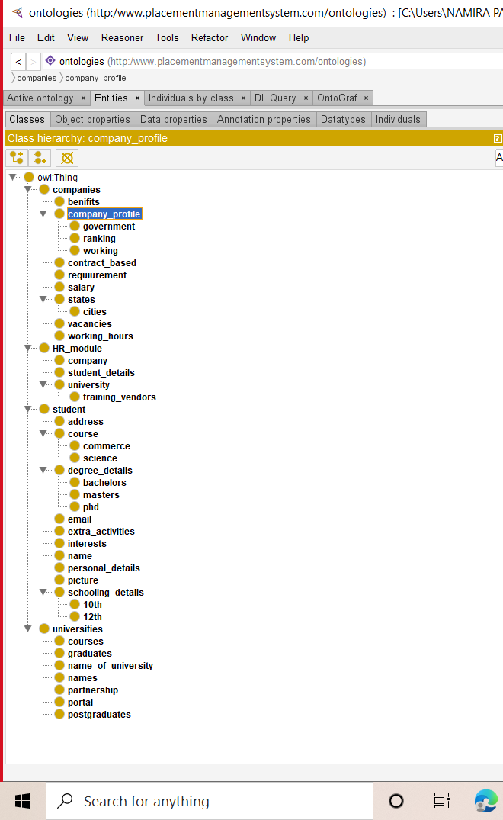

ONTOLOGIES CREATED
20XX
MAIN MODULES
STUDENT
UNIVERSITY
COMPANIES
HR_MODULE

Slide 6
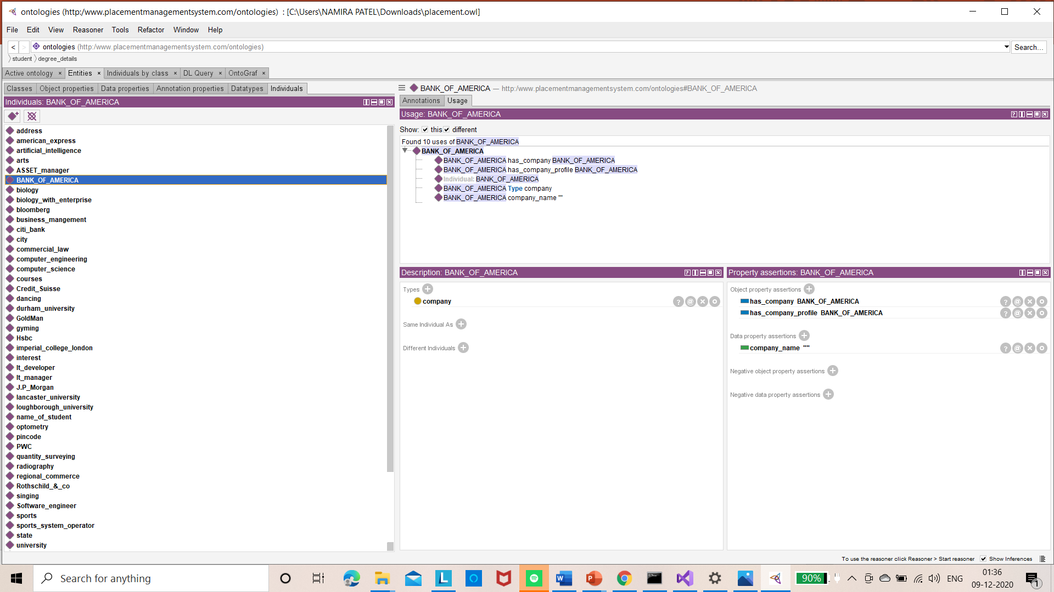
INSTANCES
.

Slide 7

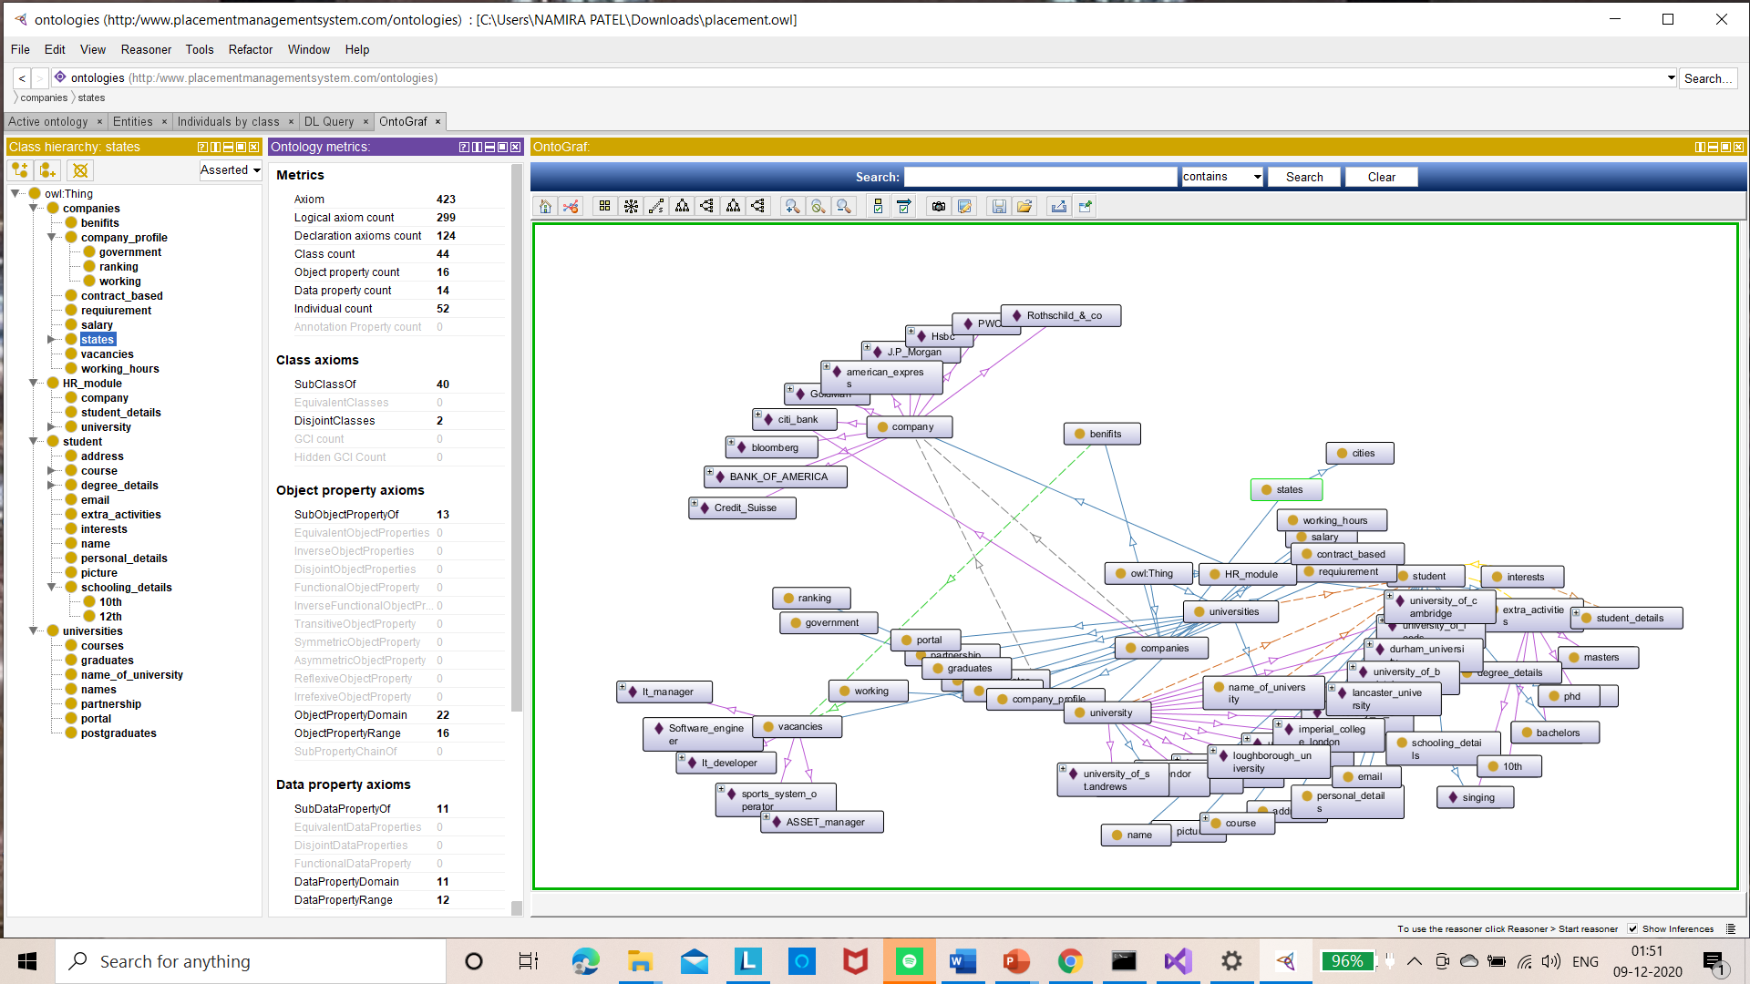
ONTOGRAPHS
20XX

Slide 8
THANK YOU!
20XX

